Slide 1
Artificial Intelligence and Machine Learning
Project
Car Price Prediction
Team Details:
Harshit Sharma 2210991641
Harshvardhan Singh 2210991647
Himanshu Kumar 2210991661
Harsh Sinha 2210991625
Faculty Coordinator:
Shubham Singhal
:
Chitkara University Institute of Engineering and Technology,
Chitkara University, Punjab

Slide 2
Table of Contents
Introduction
Objective
Problem Statement
Methodology, Approach & Techniques
Result
Conclusion
References

Slide 3
Introduction
Welcome to our presentation on car price prediction, where we delve into the innovative application of Artificial Intelligence (AI) and Machine Learning (ML) to revolutionize pricing strategies in the automotive industry.
With the rapid advancements in AI and ML technologies, predicting car prices accurately has become increasingly feasible, offering immense potential for manufacturers, dealerships, and consumers alike. This presentation explores the significance, challenges, and methodologies involved in leveraging AI and ML for car price prediction.
Join us as we embark on a journey to explore the transformative power of data-driven insights in optimizing pricing strategies and fostering transparency and efficiency in the automotive marketplace.

Slide 4
Objective
The primary objective of this project is to develop a robust predictive model for car price estimation, leveraging the capabilities of Artificial Intelligence (AI) and Machine Learning (ML) techniques. Specifically, our goals include:
Enhancing Prediction Accuracy: Implementing advanced ML algorithms to improve the accuracy of car price predictions, ensuring reliable forecasts for stakeholders.
Data Integration: Incorporating diverse datasets encompassing historical sales data, market trends, economic indicators, and vehicle specifications to capture the complex interplay of factors influencing car prices.
Model Adaptability: Designing a flexible and adaptive model capable of adjusting to evolving market dynamics and consumer preferences, ensuring its relevance and effectiveness over time.

Slide 5
Problem Statement
In the automotive industry, accurately predicting car prices remains a challenging task due to the multifaceted nature of market dynamics and consumer preferences. Traditional methods often lack the precision required to navigate this complex landscape effectively, leading to suboptimal pricing decisions and missed opportunities for stakeholders. The problem statement encompasses the following key aspects:
Prediction Accuracy
Data Integration
Model Adaptibility
Stakeholder Needs

Slide 6
Methodology, Approach & Algorithms
Methodology:-
The methodology involves collecting and preprocessing diverse datasets comprising historical sales data, market trends, economic indicators, and vehicle specifications. Feature engineering techniques enhance predictive performance. Various regression algorithms are evaluated, and the optimal model is selected based on performance metrics and cross-validation. The chosen model is trained on the dataset and evaluated using testing data to assess predictive accuracy. Upon validation, the model is deployed for real-time predictions in a production environment, with ongoing monitoring and recalibration. Comprehensive documentation summarizes the methodology, findings, and recommendations for pricing strategies in the automotive industry.

Slide 7
Methodology, Approach & Algorithms
Approach:-
Our approach combines AI and ML techniques to predict car prices accurately. We start by collecting diverse datasets, including historical sales data, market trends, economic indicators, and vehicle specifications. Next, we preprocess the data and engineer features to enhance predictive performance. We evaluate multiple regression algorithms, selecting the most suitable model based on cross-validation and performance metrics. After training the chosen model, we assess its predictive accuracy using testing data. Upon validation, the model is deployed for real-time predictions, with continuous monitoring and recalibration. Through this approach, we aim to provide stakeholders with reliable insights for informed decision-making in the automotive industry, driving efficiency and transparency.

Slide 8
Methodology, Approach & Algorithms
Algorithms:-
The car price prediction system employs a combination of traditional machine learning algorithms and deep learning architectures to analyse transaction data and identify price patterns effectively. The following algorithms are utilized in the project:
•Linear Regression: Linear regression analysis is used to predict the value of a variable based on the value of another variable. The variable you want to predict is called the dependent variable. The variable you are using to predict the other variable's value is called the independent variable.
•SVR: Support Vector Regression (SVR) is a type of machine learning algorithm used for regression analysis. The goal of SVR is to find a function that approximates the relationship between the input variables and a continuous target variable, while minimizing the prediction error.

Slide 9
Methodology, Approach & Algorithms
•Decision Trees: Decision tree-based algorithms, including Random Forests and Gradient Boosting, are utilized to capture complex nonlinear relationships and interactions between features in the transaction data.
•Random Forest: Random forest regression model combines multiple decision trees to create a single model. Each tree in the forest builds from a different subset of the data and makes its own independent prediction. The final prediction for input is based on the average or weighted average of all the individual trees' predictions.

Slide 10
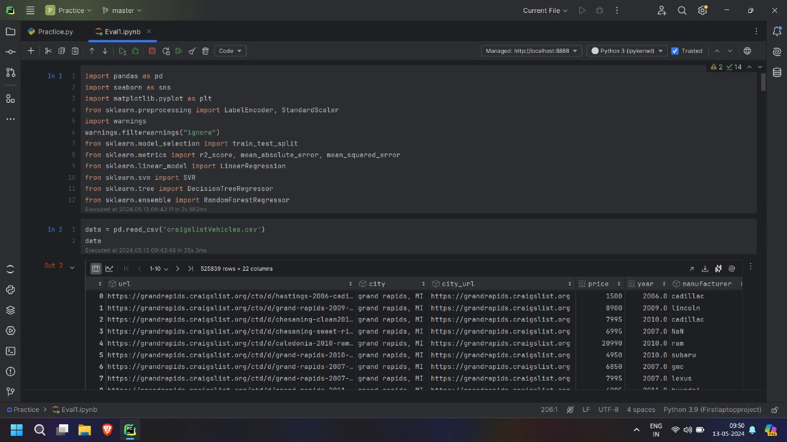
Result

Slide 11
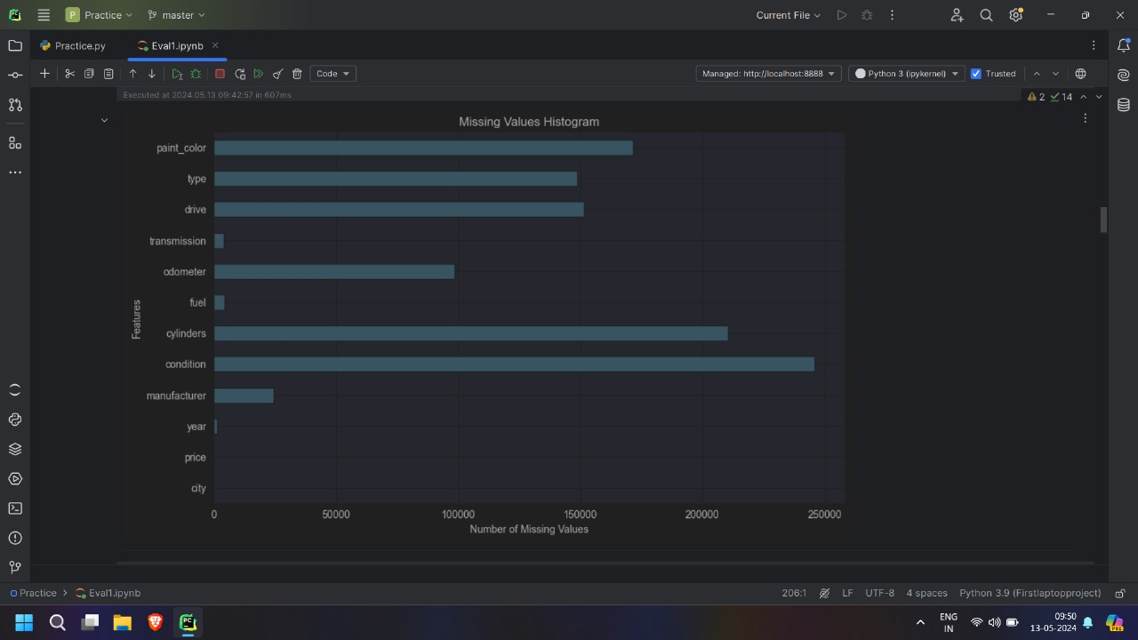
Result

Slide 12
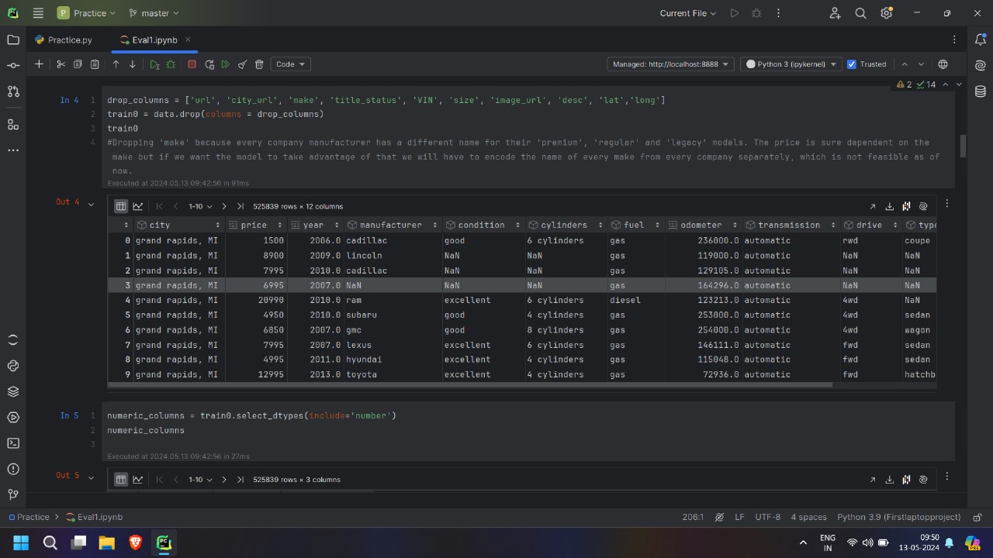
Result

Slide 13
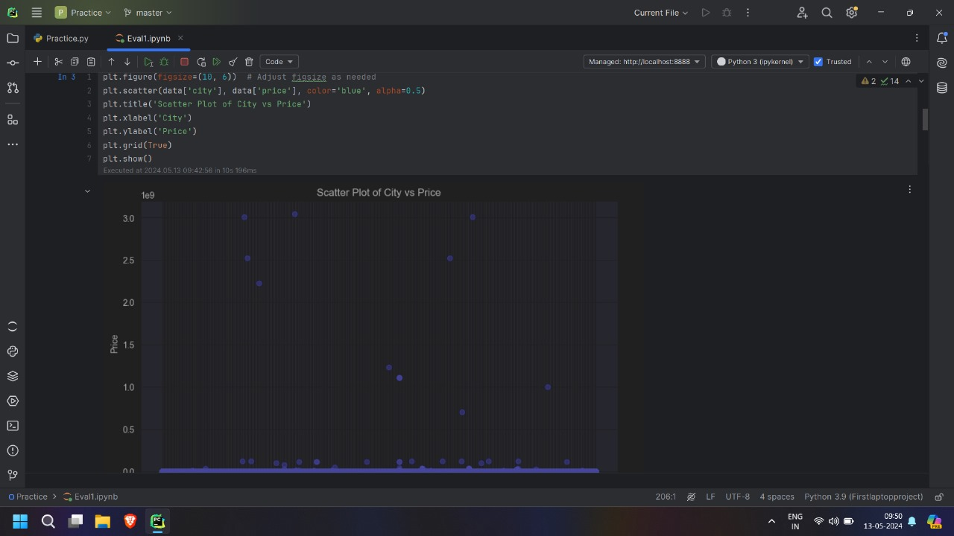
Result

Slide 14
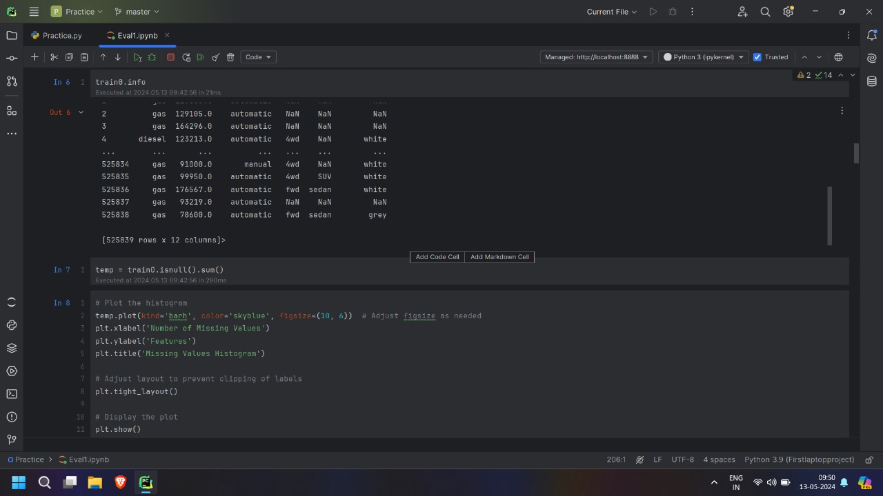
Result

Slide 15
Result

Slide 16
Conclusion
In conclusion, the Car Price Predictor AIML system offers a sophisticated solution for estimating car prices based on various factors. Through the implementation of advanced machine learning algorithms, it provides accurate predictions that can assist both buyers and sellers in making informed decisions. The system's ability to analyze historical data, consider market trends, and factor in features like mileage, brand, and year of manufacture enhances its predictive capabilities. Overall, the Car Price Predictor AIML system showcases the power of artificial intelligence and machine learning in revolutionizing the automotive industry, streamlining pricing strategies, and improving customer satisfaction. Furthermore, the system's user-friendly interface and real-time updates make it a valuable tool for anyone involved in the car buying or selling process.

Slide 17
References
The reference used are :
https://www.kaggle.com/code/vbmokin/used-cars-price-prediction-by-15-models/notebook
https://scikit-learn.org/
https://stackoverflow.com/
www.google.com

Slide 18
The End

